Slide 1
Category review: Chips
June 2020
Retail Analytics
Brand note: If client logo is not required, use alternate title page layout right click slide thumbnail > Layout > Title

Slide 2
Notes:
To view Privacy video explaining how important data privacy is to Quantium, please click here: https://www.youtube.com/watch?v=Zq1QDAkoRzU
or here Q:\Company Reference\Brand & Design\Brand videos\Q Privacy.mp4
At Quantium, we believe that data is the behavioural footprint of humanity and that it has to be treated with the utmost care and responsibility.
Histories, attitudes, indeed lives are stored within it in ways that aren’t always apparent – and that’s what makes its potential so powerful.
To work with it responsibly, sensitively, we set ourselves the highest data privacy protection and governance standards.
We have spent 17 years perfecting privacy-by-design and secure-by-design principles. Central to this is not holding any personally identifiable information about people –
we neither receive it, and put the necessary protections in place to be unable to decipher it.
Every aspect of handling data is safeguarded: from its de-identification, to its encryption – data security is paramount and of the highest grade.
We pride ourselves on gaining the trust of iconic organisations around the world through years of securely working with their data,
and in turn the trust that builds with their stakeholders.

Slide 3
Table of Contents
Problem Statement and Purpose
Methodology
Executive summary
Overview and Context
Key Findings and Insights
Recommendations and Next Steps
Summary

Slide 4
Problem Statement and Purpose
Problem statement: The Category Manager for Chips wants to better understand the types of customers who purchase Chips and their purchasing behaviour within the region.
Purpose: The insights from the analysis will feed into the supermarket’s strategic plan for the chip category in the next half year.

Slide 5
Methodology
The methodology used for the analysis involved examining the transaction dataset provided by the client to identify customer purchasing behaviours. This was done to generate insights and provide commercial recommendations to the client. Additionally, benchmark stores were identified to test the impact of trial store layouts on customer sales. The techniques used for the analysis included data cleaning and manipulation, data visualization, statistical testing, and hypothesis testing. The data sources used were transaction and purchase behaviour data provided by the Category Manager of chips.

Slide 6
Executive summary
01
Chips Category Review
Chips sales increase before Christmas, presenting an opportunity for promotional offers.
Mainstream young singles/couples and midage single/couples customers are willing to pay more for chips, while premium shoppers are less likely to buy chips.
Budget older families, Mainstream young singles/couples, and Mainstream retirees are the main chip buyers.
02
Trial Store Analysis
Trial stores 77 and 86 showed a significant increase in sales and number of customers during the trial period, while trial store 88 did not show any significant change.
The trial stores 77, 86, and 88 had higher total sales and number of customers compared to their control stores 233, 155, and 237, respectively. This indicates that the trial stores were successful in increasing sales and attracting more customers during the trial period.
The trial in store 88 was successful in increasing total sales during the trial period compared to its control store, and the trial store's sales were outside the 5th and 95th percentile range of the control store's sales.

Slide 7
Overview and Context
The chips category has been performing well over the last six months, However, there are opportunities for improvement to conduct data analysis for the Category Manager for Chips in order to gain insights into customer behaviour and performance in trial vs control stores. The insights gained from the analysis will be used to inform the supermarket's strategic plan for the chip category in the next half year. The tasks involve examining transaction and customer data, defining metrics, exploring the data, creating charts and graphs, and providing recommendations based on the insights gained.

Slide 8
01
Category

Slide 9
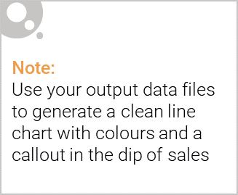
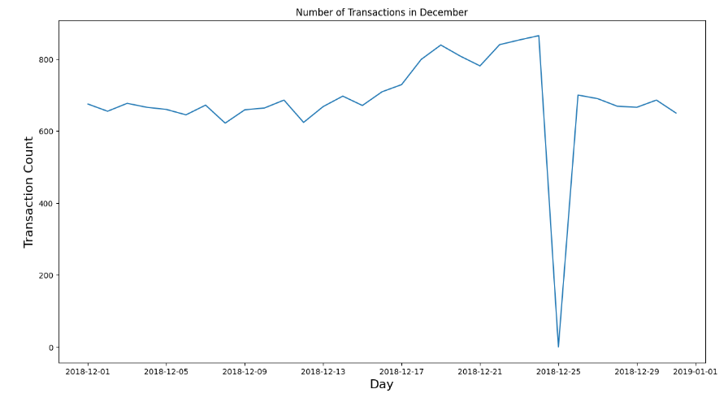
We can see that the increase in sales occurs in the lead-up to Christmas and that there are zero sales on Christmas day itself. This is due to shops being closed on Christmas day.

Slide 10
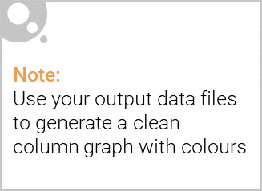
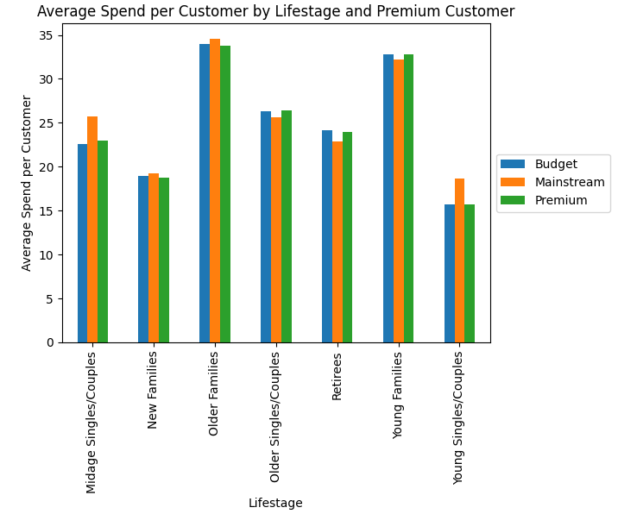
There are more Mainstream - Older Families and Budget - Young Families who buy chips. This contributes to, there being more sales to these customer segments but this is not a major driver for the Budget - Young Single/Couples.

Slide 11
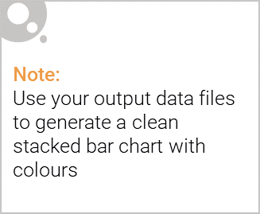
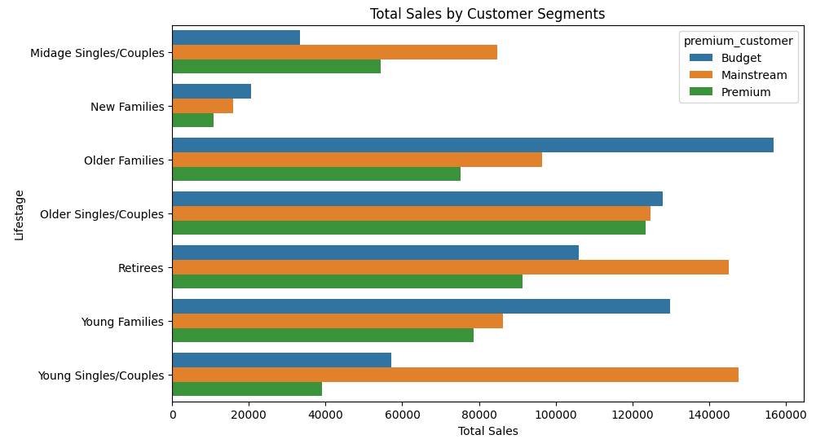
Editable (delete this)
Sales are coming mainly from Budget - older families, Mainstream - young singles/couples, and Mainstream – retirees. It could be useful for the Category Manager to focus their marketing and promotional efforts on these segments to drive further growth and increase market share.

Slide 12
Key Findings and Insights
Through our analysis, we identified several key findings and insights, including:
Brand Kettle had the highest sales in the chips category, followed by Doritos, and Pringles. This suggests that the assortment of these brands should be increased in the stores.
The older families, retirees, and young singles/couples segments purchase the most chips in terms of quantity. The budget - older families and mainstream - retirees are the largest purchasers by volume and this is the driver behind the higher sales.
Findings suggest that there are distinct segment differences in chip purchasing behaviour, including brand preference, pack size preference, and willingness to pay more for chips.

Slide 13
02
Trial store performance

Slide 14
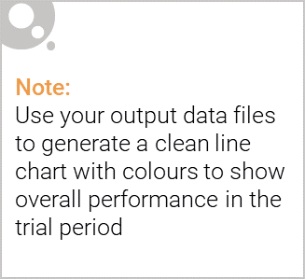
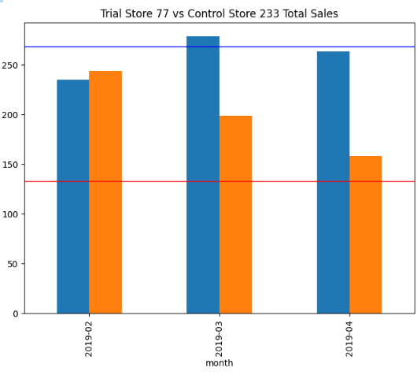
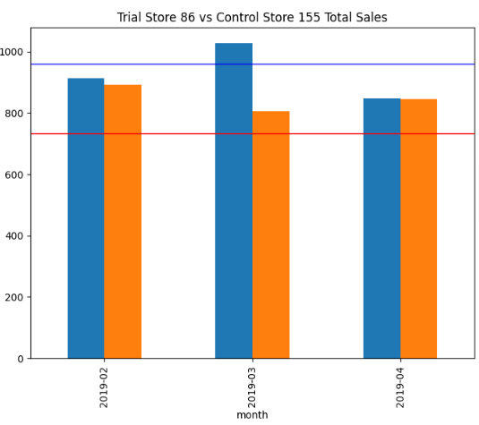
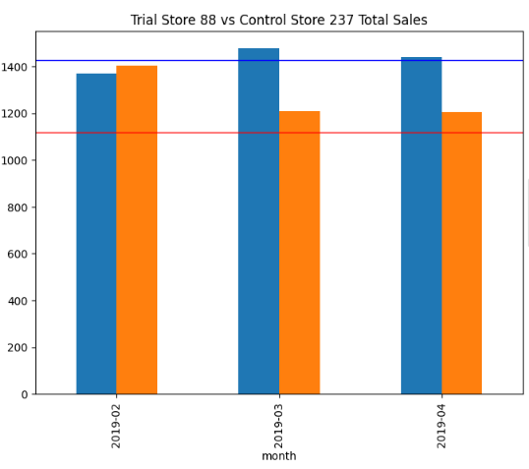

Statistically insignificant sales difference is observed in Trial Stores, except for March Performance. Store 88 had a Successful Impact on Sales.

Slide 15
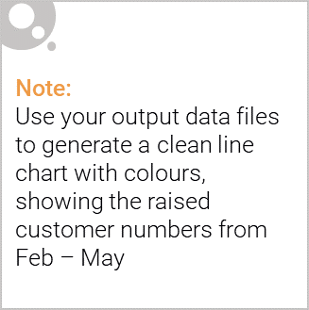
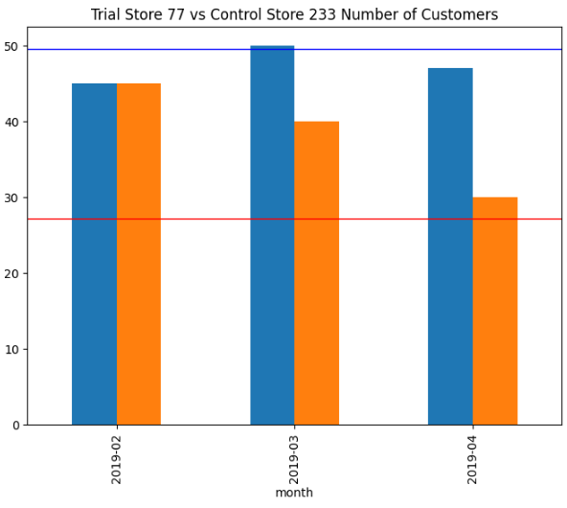
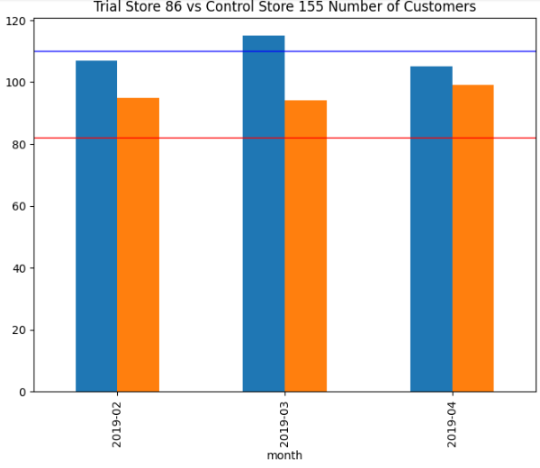
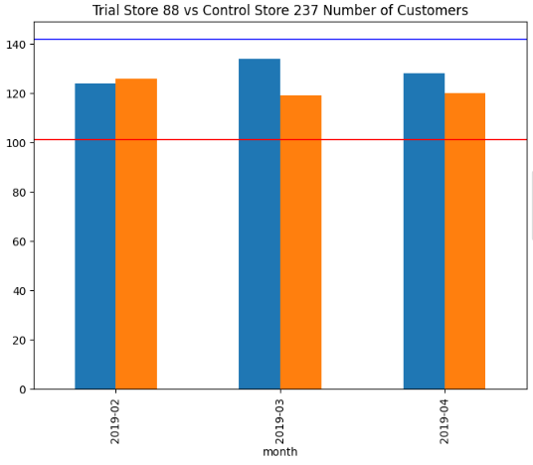
Successful Improvement in Customer Numbers in Stores 77 and 86, Further Analysis Required for Store 88.

Slide 16
Key Findings and Insights
Through our analysis, we identified several key findings and insights, including:
The trial stores 77 and 86 showed a significant increase in customer numbers during the trial period compared to the control stores, indicating that the trial was successful in these stores.
In store 88, there was an improvement in customer numbers, but it was not statistically significant when compared to the control store, indicating that the trial was not as successful in this store.
The trial in store 77 and 86 was successful in increasing total sales during the trial period compared to its control store, although it did not exceed the 95th percentile value of the control store's sales in two months.
The trial in store 88 was successful in increasing total sales during the trial period compared to its control store, and the trial store's sales were outside the 5th and 95th percentile range of the control store's sales

Slide 17
Recommendations and Next Steps
Based on the analysis, it is recommended that the Category Manager of chips implement the layout changes tested in Trial Store 86 across all stores. Additionally, the insights gained from the analysis can be used to inform future trials and decision-making processes. The Category Manager should consider conducting further analysis to determine the underlying factors contributing to the success or lack thereof in each trial store.

Slide 18
Summary
The analysis identified that the trial in stores 77 and 86 was successful in increasing customer numbers, while the trial in store 88 had a statistically significant increase in sales compared to its control store. It is recommended that the Category Manager of chips implement the layout changes tested in Trial Store 86 across all stores and use the insights gained from the analysis to inform future trials and decision-making processes.

